Slide 1

CS 533 INTRO TO DATA SCIENCE
Michael Ekstrand

Slide 2
FEATURES

Slide 3

Learning Outcomes
Compute new features for observations
Think about feature relatedness
Preview: split data
Photo by Logan Clark on Unsplash

Slide 4
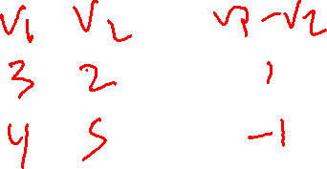
Features
Penguins:
Bill length
Bill depth
Flipper length
Body mass
Can compute:
Bill aspect ratio
Augments data with a new feature

Slide 5
Featured Selection
Things we’ll want to do:
Extract features
Select features
Rescale, normalize, and transform features
Combine features into new ones
These can improve performance and interpretability.

Slide 6
Desired Feature Properties
Well-distributed
Normal often easiest to work with
Interpretable, if we’re doing inference
Uncorrelated
Two correlated features may not contribute more value!
Cause problems with some models!

Slide 7
Beware
Don’t look at correlation between outcome and predictors in exploration!
Biases your feature selection
Hold out testing / validation data, then explore your “training data”.

Slide 8

Wrapping Up
We want to take care in curating and transforming features.
We’re going to need to split data into pieces soon.
Photo by James Fitzgerald on Unsplash

